Slide 1

Indian Restaurant
Raising the profit of an Indian takeaway restaurant by giving marketing suggestions of association supported by data.

Slide 2

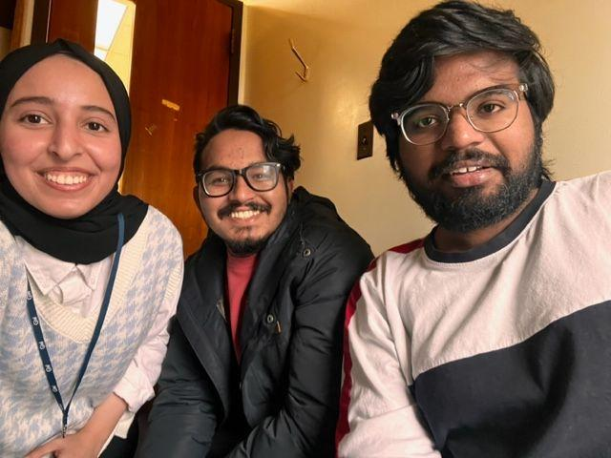
Team
Amjad Altuwayjiri - Kismat Khatri - Sai Dontukurti
Notes:
Can we take a picture of us all together and past it here with the cartoons hats on? it will be sweet!

Slide 3
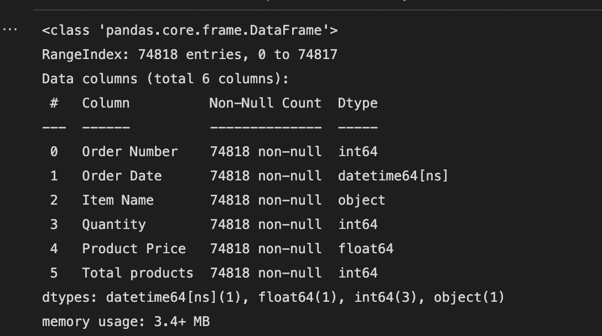
About the data
Added columns:
Total Price​​ | total payment for a customer
Time | time of order placing
Date | Date of order placing
Day | Name of the day in the week
Main Columns:
Order Number | receipt number.
Order Date | date and time of the order.
Item Name | name of the order in the menu.
Quantity | number of orders per item for the receipt.
Product Price | item price without counting the quantity.
Total products | total number of items per receipt.
___ ___ ___ ___ ___ ____ ____ ____ ____
___ ___ ___ ___ ___ ____ ____ ____ ____
Notes:
Talk briefly about:
source of the data: “Indian takeaway restaurant’s dataset placed in London, UK from the year of 2016 to 2019 .”
columns: main columns and how we created the new columns

Slide 4
Questions to investigate
Quantity:
- What is the most ordered product?
- What is the least ordered product?
- What is the quantity of product ordered each day, week, year?
Profit:
- What is the average profit of the day, week, year?
- How to raise the profit by using role of association?
Notes:
The main focus of this project is product quantity and restaurant profit so we are interested to know:

Slide 5
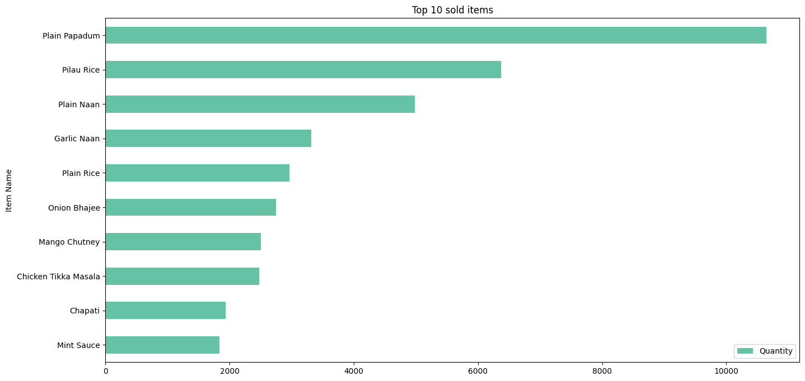
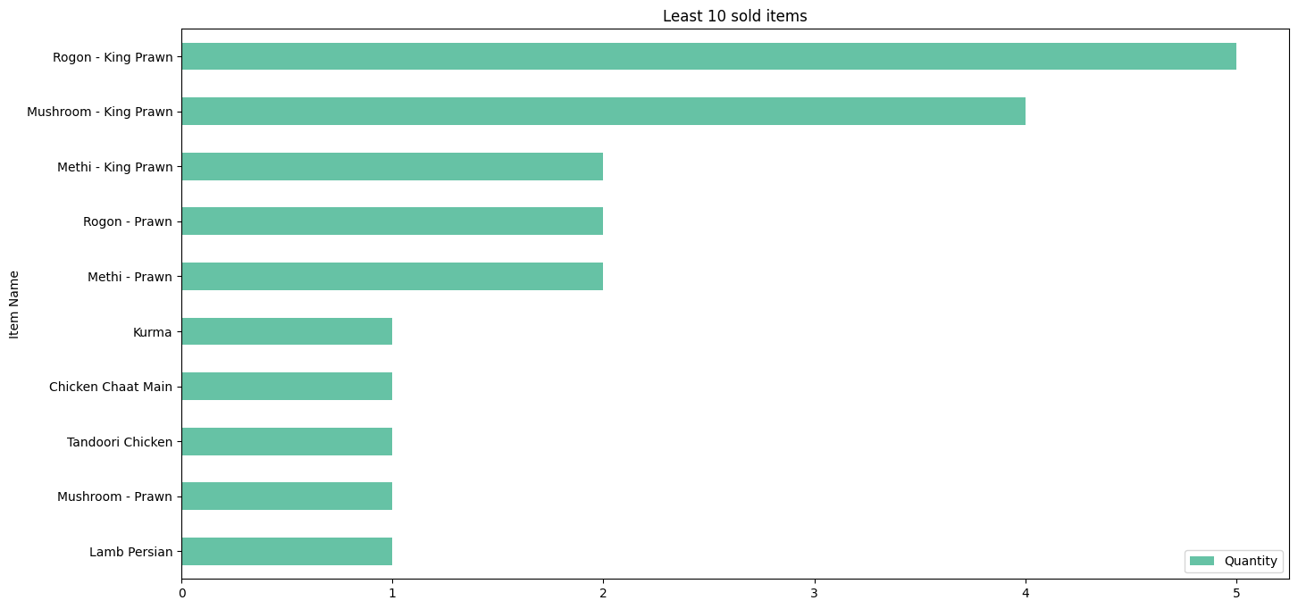
Most ordered product
Least ordered product
Notes:
Restaurant 1 contains the following:-
Orders ~13k
Rows ~75k
Products 248
In the whole data of (this number) of years the most ordered product is Plain Papadum being ordered 10000 times. On the other hand during the same time the least ordered product is multiple items of Prown, Kurma and Lamp Persion being ordered only once.

Slide 6
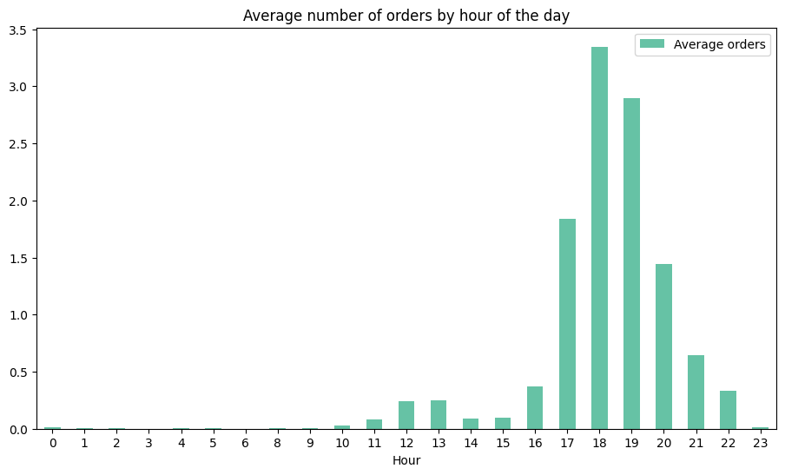
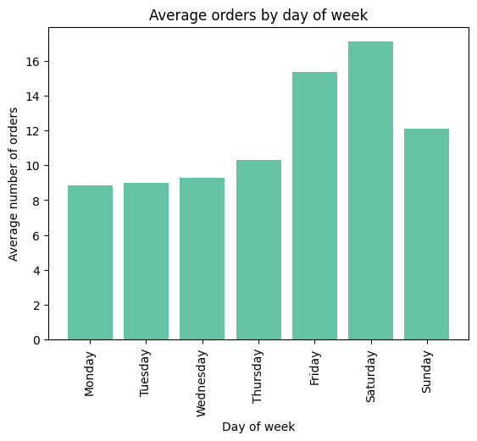
Quantity per time
Daily
71
weekly
497
Monthly
2122
___ ___ ___ ___ ___ ____ ____ ____ ____
Notes:
Usually customers start ordering from 10 o'clock in the morning. The rush horse start from 4 o'clock and the peak is at 6 then orders decline until 12 o'clock in the evening. For the days, Fridays and Saturdays are the most busiest days in the week, and we have to point out that UK weekends are saturday and sunday. Therefore we can say that the average number of orders in the weekends is higher than the weekdays.

Slide 7
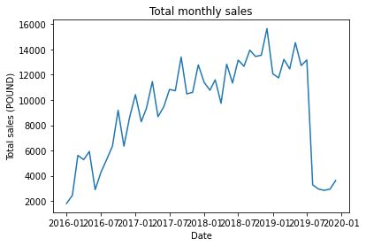
Profit per time
Daily
342
weekly
2388
Monthly
10193
___ ___ ___ ___ ___ ____ ____ ____ ____
___ ___ ___ ___ ___ ____ ____ ____ ____
Notes:
Two heatwaves accounted for the 892 deaths. The first, from 21 to 28 July, included the highest temperature ever recorded in the UK: 38.7C in Cambridge. The second occurred between 23 and 29 August.

Slide 8
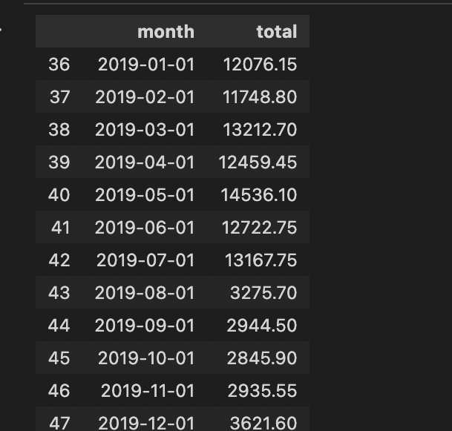
Total sales is comparable in the first seven month of 2019.
But In August 2019, there is major decline in total sales
Notes:
Flooding in much of England in November. 2019 was the wettest year on record

Slide 9
Raise profit by using role of association
1
Grouping items
Notes:
What is it? When you know that 90% of your customers when they buy Burger they buy Soda with it, it is doing algorithms to find relationship between items.
But before that we needed to prepare the data, so we identified an issue started by realizing that we have Plain Naan, Garlic Naan, Keema Naan! They are all Naan! Though they have different names, they can’t be treat differently it’s just Naan after all. So we grouped items under the supervision of the elite, and who is more expiry than my Indian people!

Slide 10
Bill number | Item name
1 | Naan
1 | Masala
1 | Water
2 | Naan
3 | Masala
One hot Encoding
2
Bill number | Naan | Masala | Water
1 | 1 | 1 | 1
2 | 1 | 0 | 0
3 | 0 | 1 | 0
Notes:
Then we moved to the next step. Simply explain the underhood of the algorithm

Slide 11
Item | Associated | confident | left
(Madras, Chutney) | Papadum | 0.89 | 3.1
(Papadum, Butter Chicken) | Rice | 0.95 | 1.3
(Aloo, Rice, Curry) | Naan | 0.80 | 1.3
3
Applying Apriori
Notes:
Explain the end result with the first associated items – I have to know what is the left is for –
So instead of going like guessing what people buy with what, it is proven by numbers!

Slide 12
Raise the sales for the least ordered items
Analyzing Result
Sale for the associated item in the weekdays
4
Visual marketing combo
Notes:
What are the benefits:
1- not random tries and “what do you think” kanda question. We can check what is associated with Korma and target customers who buy the combinations of items to try Korma with it!
2- If you buy Madras and Chutney, you will have Papadum with it for free during the weekdays!
3-In the restaurant pictures, menu and website it would be appealing to customers to see their favorite combos together

Slide 13
THANK YOU…

